Slide 1
ANALYTICS FOR BUSINESS INTELLIGENCE
FINAL PROJECT
(FALL 2021)
ANUSHA SAVARAM

Slide 2
GOAL
This project seeks to analyse the deficiencies in the model used by a company to provides feedback to the caregivers. The objective of the feedback is that the caregiver - patient relationship improves, patients avoid going to nursing homes

Slide 3
INTRO TO DATA DUMP
The dataset is a collection of 6090 assessments
It talks about burden scores given by the patients to their respective care givers
It provides a question wise rating by the patients to his/her caregiver
This analysis seeks to identify the satisfaction levels of care receiver using assessment ratings and discrepancies in the same
The other details include gender, marital status, health scores, race.

Slide 4
INTRO TO VARIABLES USED
Caregiver Name: CG_FName & CG_LName
Patient/Care Receiver: CR_FName & CR_LName
Time of interview: started_at & ended_at
Assesment_status
Question & Answer Scores from Column BJ - IE
6 Burden scores:
d_score
r_score
o_score
s_score
u_score
cesd_score

Slide 5
ATTRIBUTES & DATA TYPE
VARIABLE | DATA TYPE
Caregiver Name | String
Patient/Care Receiver | String
Time of interview | Date Time
Assesment_status | Categorical
Question & Answer Scores from Column BJ - IE | Numerical
6 Burden Scores | Numerical

Slide 6
BURDEN SCORE & THEIR RANGE
Score 1: d_score
d_score is a summation of d_1 to d_6 scores
Each question ranges from 0 to 6 points
Total Marks: 6*6=36 points
Questions
d_1: The things I am responsible for do not fit very well with what I want to do.
d_2: I am not sure that I can accept any more responsibility than I have right now.
d_3: I am not always able to be the person I want to be when I am with my spouse/partner/parent.
d_4: It is difficult for me to accept all the responsibility for my spouse/partner/parent.
d_5: I am having trouble accepting the way I relate to my spouse/partner/parent.
d_6: It is difficult for me to accept any more responsibility that I now have to assume.

Slide 7
Score 2: r_score
r_score is a summation of r_1 to r_5 scores.
Each question ranges from 0 to 5 points
Total Marks: 5*5=25 points
Questions
r_1: caused conflicts with your relative?
r_2: increased the number of unreasonable requests made by your relative?
r_3: caused you to feel that your relative makes demands over and above what he/she needs?
r_4: made you feel you were being taken advantage of by your relative?
r_5: increased attempts by your relative to manipulate you?

Slide 8
Score 3: o_score
o_score is a combination of o_1 to o_6 scores.
Each question ranges from 0 to 5 points
Total Marks: 6*5=30 points
Questions
o_1: decreased time you have to yourself?
o_2:kept you from recreational activities?
o_3: caused your social life to suffer?
o_4: changed your routine?
o_5: given you little time for friends and relatives?
o_6: left you with almost no time to relax?

Slide 9
Score 4: s_score
s_score is a combination of s_1 to s_5 scores
Each question ranges from 0 to 5 points
Total Marks: 5*5=25 points
Questions
s_1: created a feeling of hopelessness?
s_2:made you nervous?
s_3: depressed you?
s_4: made you anxious?
s_5: caused you to worry?

Slide 10
Score 5: u_score
u_score is a combination of u_1 to u_6 scores.
Each question ranges from 0 to 5 points
Total Marks: 6*5=30 points
Questions
u_1: given your life more meaning?
u_2: made you more satisfied with your relationship?
u_3: given you a sense of fulfillment?
u_4: left you feeling good?
u_5: made you enjoy being with your relative more?
u_6: made you cherish your time with your relative?

Slide 11
Score 6: cesd_score
cesd_score is a combination of cesd_1 to cesd_10 scores.
Each question ranges from 0 to 4 points
Total Marks: 10*4=40 points
Questions
cesd_1: I was bothered by things that usually don't bother me.
cesd_2:I had trouble keeping my mind on what I was doing.
cesd_3: I felt depressed
cesd_4: l felt that everything I did was an effort.
cesd_5: I felt hopeful about the future.
cesd_6: I felt fearful.
cesd_7: My sleep was restless.
cesd_8: I was happy.
cesd_9: I felt lonely.
cesd_10: I could not "get going".

Slide 12
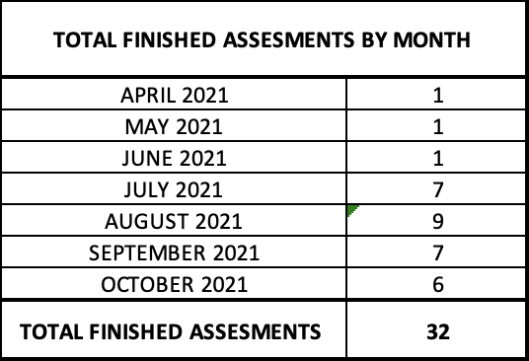
EXPLORATORY DATA ANALYSIS
Number of Caregivers: 3101
Number of patients/ care receivers: 2909
Number of Caregiver - patients: 3160

Slide 13
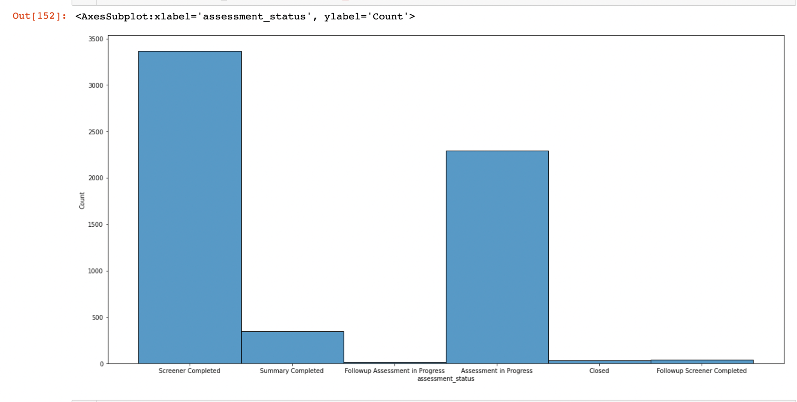
CASE WISE ASSESSMENT STATUS

Slide 14
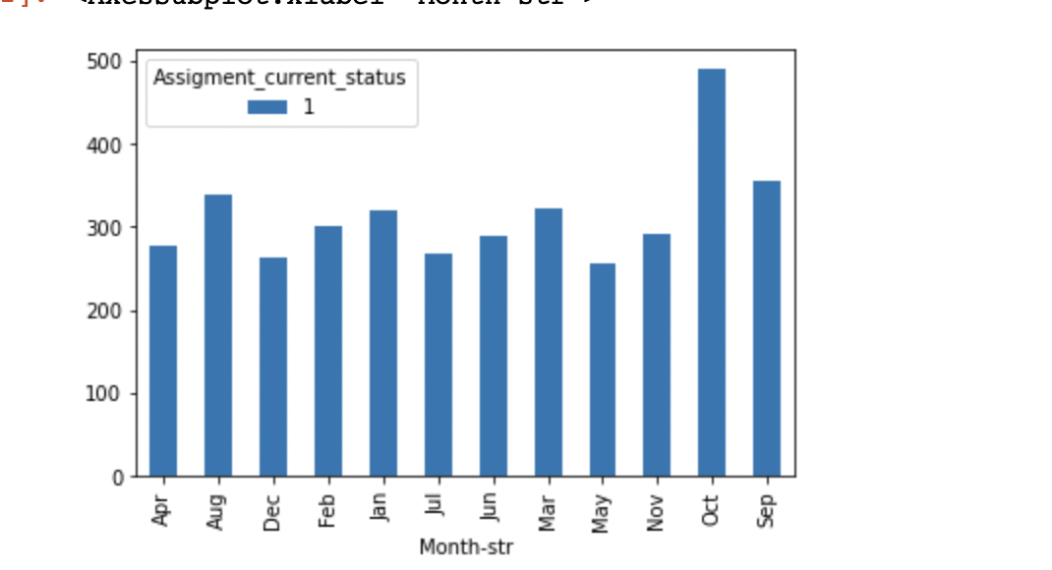
MONTH WISE ASSESSMENT STATUS
The graph represents the assessment that have the following status
Screener completed
Summary completed
Follow up screener completed
Closed

Slide 15
MAIN PROBLEM WITH THE DATA SET
There is duplicity in data recording & the score for the same assessment are recorded under multiple timestamps. This implies that the same scores are being recorded either under the same timestamp or a different timestamp more than once, leading to lack of volatility in the scores.
SOLUTION
Record the assessment results once the assessment is marked completed only once to reduce the cost, effort and obtain accurate results without duplication. This will increase volatility in the scores giving insights on genuine feedback

Slide 16
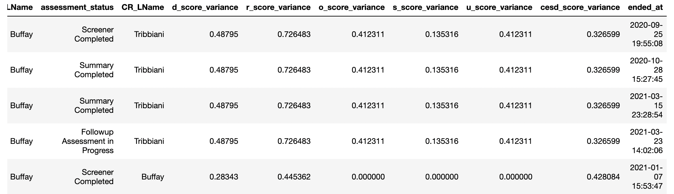
ANALYSIS OF SCORE VARIABILITY - NUMERICAL MODEL

Slide 17
OBSERVATIONS
In the case of caregiver Phoebe Buffay and care receiver Joey Tribbiani, there are same variances within respective scores in different assessments(screener completed, summary completed and Follow Up assessment in progress) at different time stamps. This could be because the patient has not taken the assessment seriously and marked same points across assessments.
In addition to the above, the ‘summary assessment’ is recorded twice post completion. Hence same scores. (Effort and cost duplication - not recommended)
In another instance of caregiver Phoebe Buffay and care receiver Frank Buffay, there are same variances in scores in ‘screener completed’ & ‘Assessment in Progress’
Further the assessments are in progress even after the case is closed.
The lack of volatility is due to mismanagement in data recording
Same variance observations across assessments could be due to assessments not be conducted and taken seriously

Slide 18
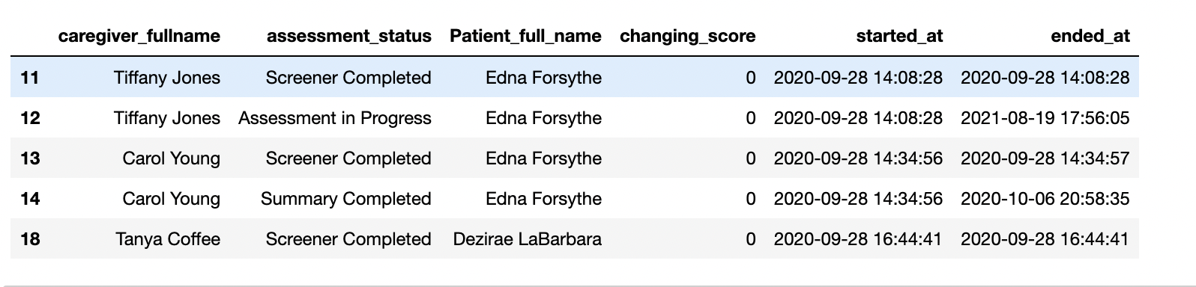
ANALYSIS OF SCORE VARIABILITY - CATEGORICAL MODEL
Model: K-Nearest Neighbours
1- Score Changed
0- Score Not change

Slide 19
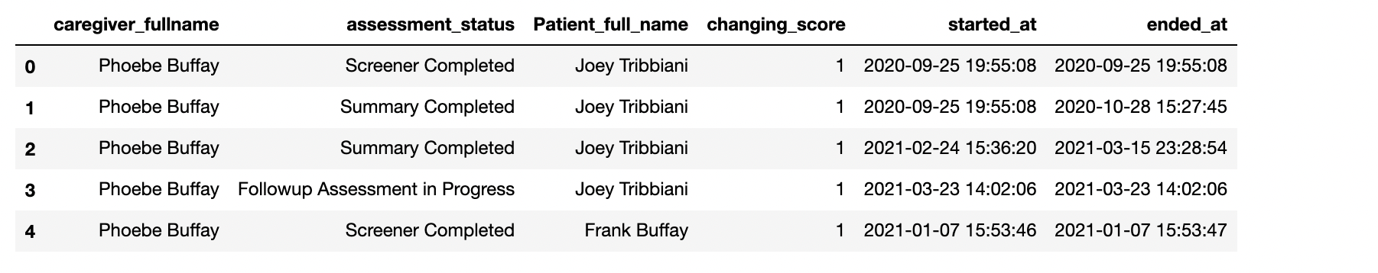
Using the categorical model we can filter the caregivers who had a change in their scores across different assessments & the caregivers that did not have volatility in their scores.
Index 1,2: The assessment “Summary Completed” has been recorded twice at different time stamps. Despite of the duplication, there is also a variation in the scores recorded. Care receiver Joey may have recorded his response twice in respect of the services provided by caregiver Phoebe Buffay. Inconsistent scores further imply that the assessments were not taken seriously and this should be modified.
Index 3: Assessment scores are being noted down even when the assessment is in progress. This should be discouraged. A score should be noted down only once the assessment is completed, lest the scores will change.

Slide 20
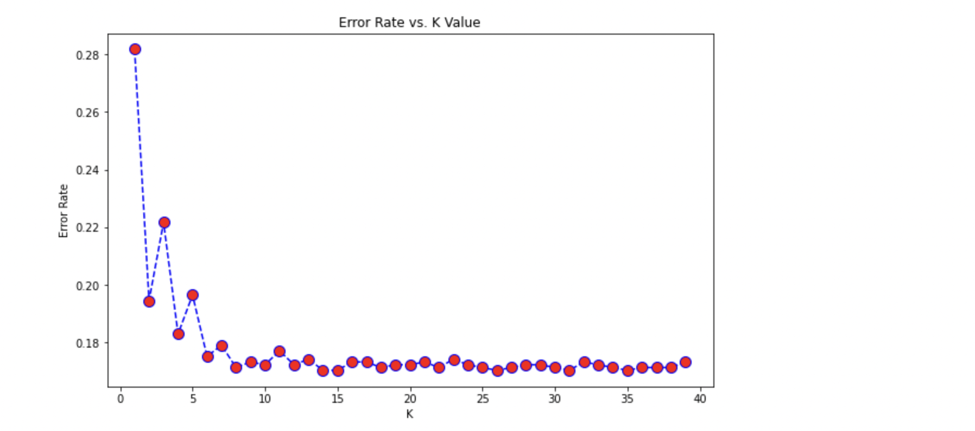
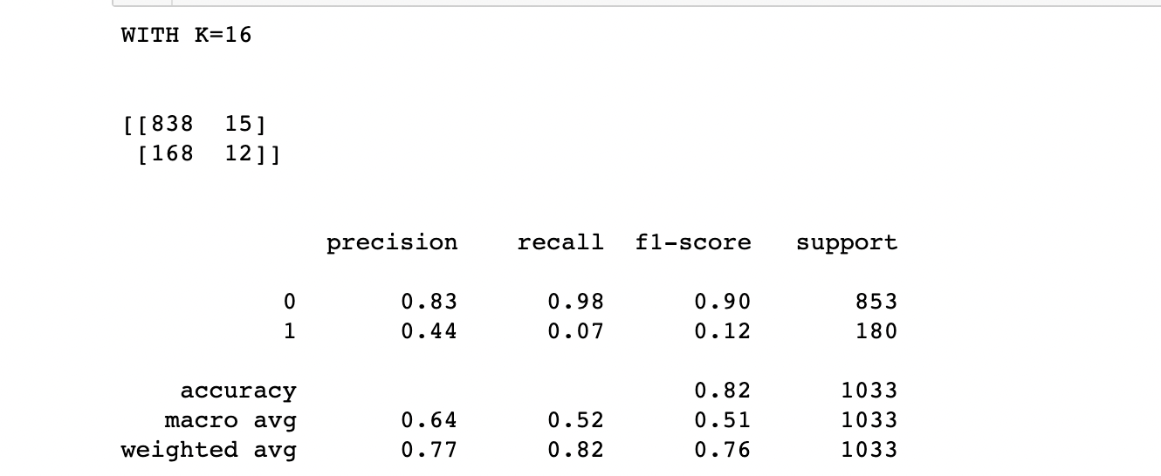
KNN MODEL

Slide 21
We passed the 6 burden scores in consideration through KNN model to categorise data as changing and not changing. We further computed percentage change in scores.
We used k=16, n=11 and train-test split of 70% and 30%
This model has 82% accuracy and 0.91 F1 score. It has a 83% precision for changing score and 44% precision for scores not changing

Slide 22
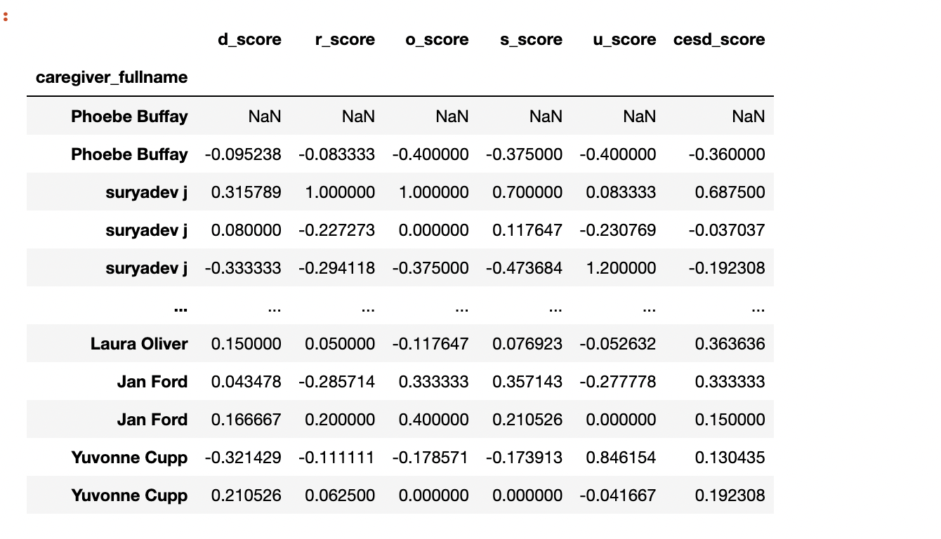
PERCENTAGE CHANGE OF BURDEN SCORES

Slide 23
INFERENCES
Issues with the company’s assessment and feedback system:
A patient attempts the same assessment multiple times leading to inconsistent data.
Even after the assessment is completed, the scores are recorded multiple times leading to lack of volatility, wasted effort and increased costs.
Tests are not taken seriously by the patients leading to inconsistent and wrong feedback.
There is a probability that few services are not provided to all the patients leading to default/wrong or null/0 marking of answers to the questions of different burden scores. This leads to bad, inconsistent, duplicate and non-volatile data.
Even when the assessment is in progress the scores are recorded multiple times leading to different scores of same assessment with different time stamps. This further leads to wrong data and incorrect feedback.
At times the assessments are in progress even when the case is closed. Either the assessments are left mid way or its the sheer mis-management of the feedback system.

Slide 24
Solutions to the issues in company’s assessment and feedback system:
Once the assessment is marked complete, immediately the score should be recorded only once
There should be a system, where a single type of assessment can be taken by the patient only once and can be re-opened only after special permissions are granted.
Scores to the services that are not provided for a specific case should be specially handled and should not be included for calculation of overall scores. Patients should not be posed with questions pertaining to the services that are not involved in their case.
Scores should not be recorded while the assessment is in progress as the scores can be changed anytime before submission.
Once the case is closed, any sort of assessment should be not be conducted and the open assessments should be terminated on case by case basis in order to avoid duplicate or irrelevant scores
For the assessments to be taken seriously by the patients a voucher or discount system should be introduced which will be rewarded once the assessment is taken genuinely and feedback is provided accurately. Incentivising patients, even small amounts, can be a major boost to the feedback system. These feedbacks can later be analysed and strategic business decisions can be taken to enhance caregiver patient relationship. Afterall, a patient’s satisfaction is a deciding factor for successful running of the company’s business.

Slide 25
THANK YOU

